Slide 1
Ancient Woodlands
Ancient Wodlands in the Chilterns Area of Outstanding Natural Beauty threatened by the construction of the HS2 rail link

Slide 2
Contents
Vn 1.0 3-Jan-2015
Slide Subject
3 Where are they
4 Mantles & Farthings Wood
5 Mantles Wood
6 Farthings Wood
7,8 Sibley’s Coppice
9,10 Jenkins and Havenfield Woods
11,12 Jones’ Hill Wood
13,14 Grim’s Ditch

Slide 3
Where are they ?
Lost Woodland
Jones’ Hill 1 ha (50%)
Jenkin’s Wood Uncertain
Sibley’s Coppice 2.4 ha (30%)
Farthings Wood 0.5 ha
Mantle’s Wood 6.2ha (30%)
( from the Woodland Trust response to the ES )

Slide 4
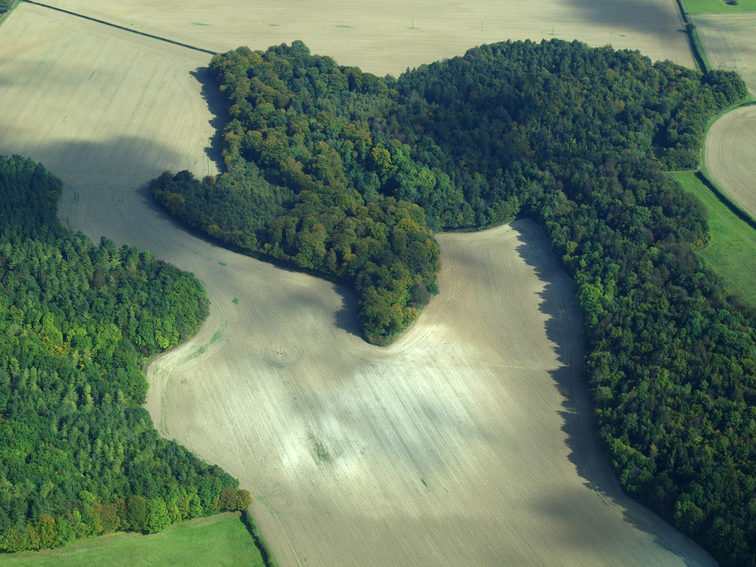
Mantle’s and Farthings Woods
The 6.2ha removed from Mantle’s Wood is the largest loss of Ancient Woodland on Phase 1, and divides
the wood in three.
A permanent access road to the
Portal also passes through the wood.

Slide 5
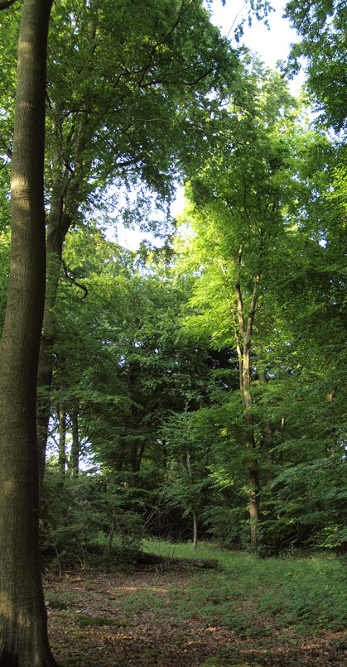
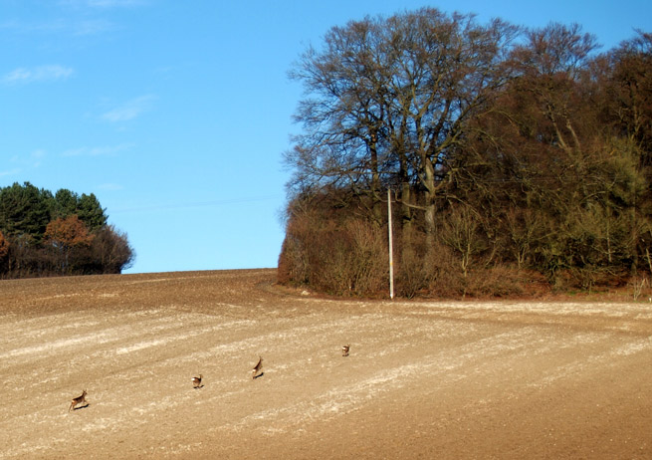
Mantle’s Wood
Construction of a tunnel portal and associated site
compounds within irreplaceable ancient woodland is
completely unacceptable … 
(Woodland Trust,
ES response )
Site of the Tunnel Portal

Slide 6
Farthings Wood

Slide 7
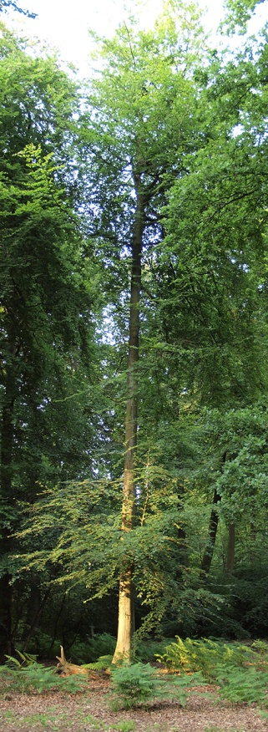
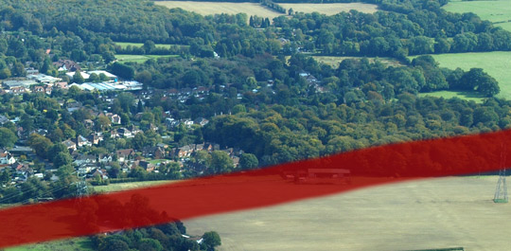
Sibley’s Coppice
Sibley’s Coppice
Sibley’s Coppice is bordered by South Heath on two sides. Footpaths through the wood are “much used by the local community”. One-third will be inaccessible for up to two years. Since this is a “permanent loss of irreplaceable habitiat”⁼, the effect cannot be described as
temporary
⁼ ES CFA10, 7.4.35

Slide 8
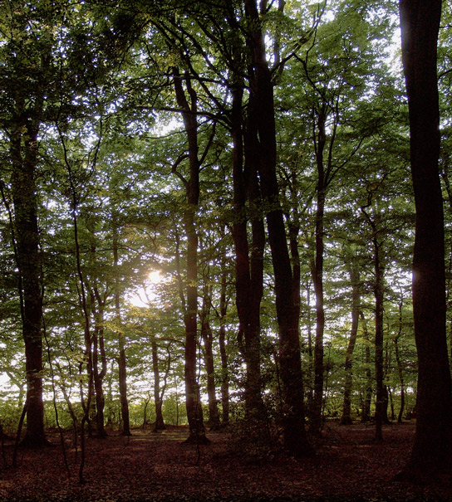
Sibley’s Coppice
The area reinstated over the cut and cover (or “green”) tunnel will bear little resemblance to the existing woodland, for the next hundred years or so …

Slide 9
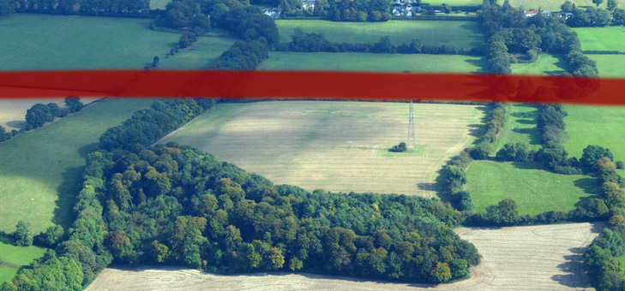
Jenkins’ and Havenfield Woods
“The ES contains conflicting information on two of the remaining four woods
(Jenkins Wood and Havenfield Wood), with one section stating no loss to the
woodland and other section(s) indicating that there will be a direct impact.”
(Woodland Trust, ES response)
Havenfield Wood, a few hundred metres from the cutting →

Slide 10
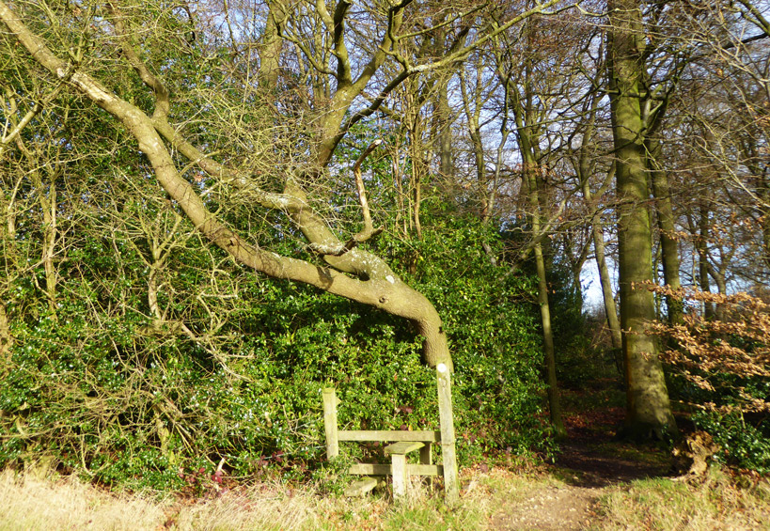
Jenkins’ and Havenfield Woods
↑ Footpath through Jenkins’ Wood, which
will emerge at the South Heath Tunnel Portal
Holly in Havenfield Wood →

Slide 11
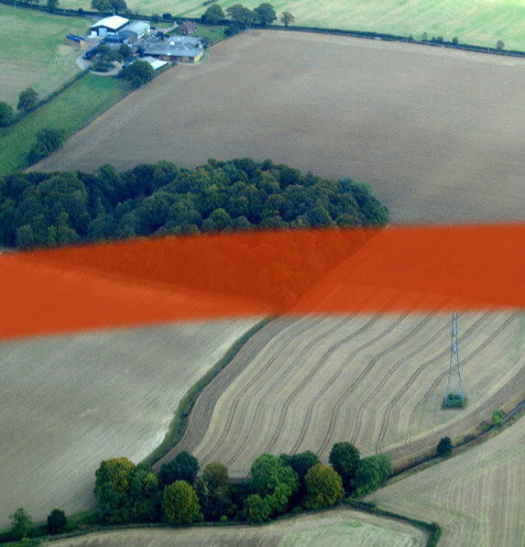
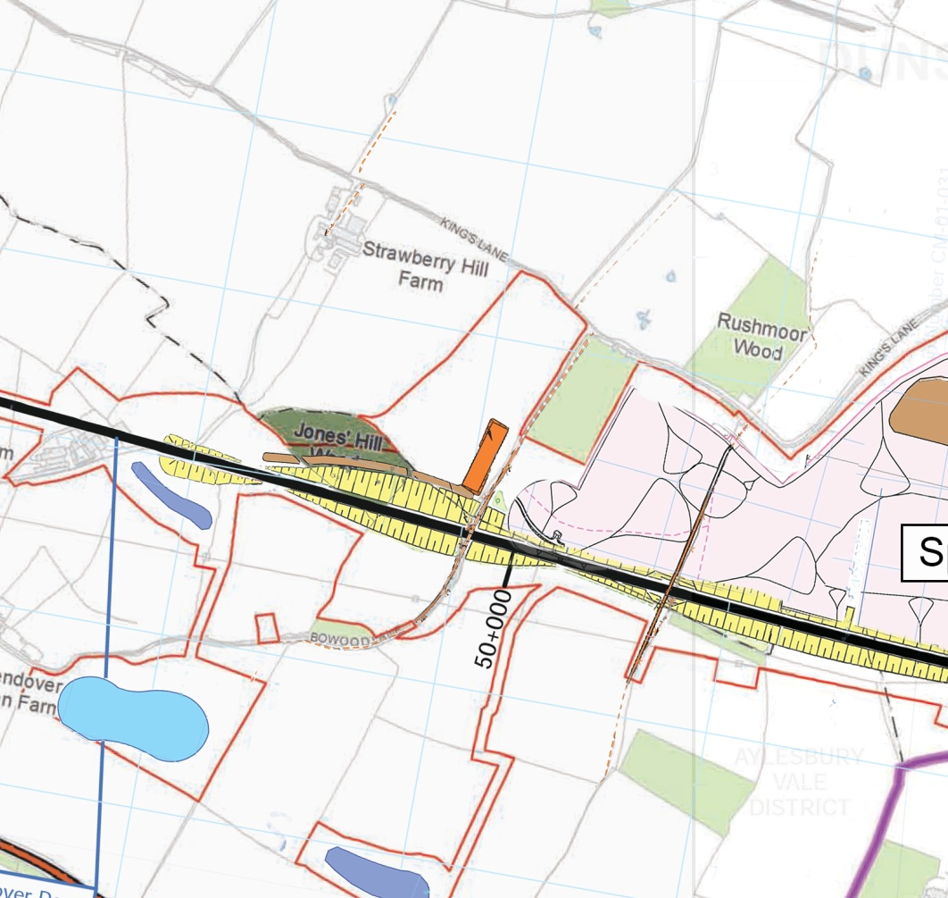
Jones’ Hill Wood
CFA10, 7.4.41: Anticipated significant residual ecological effects during construction are:
the permanent loss of approximately 1ha of ancient woodland from Jones' Hill wood, which is irreplaceable;

Slide 12
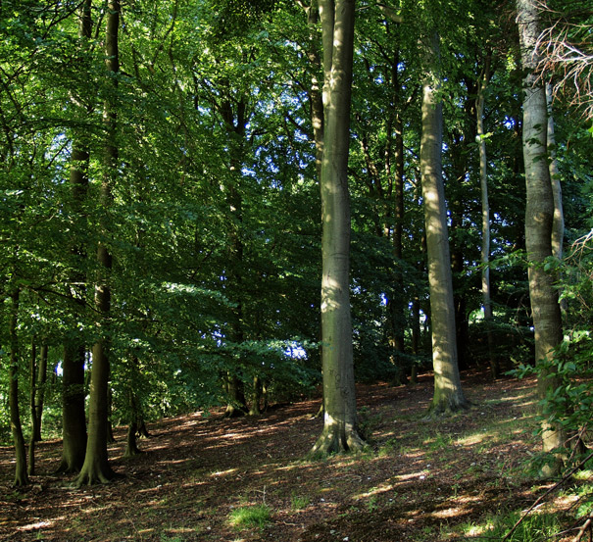
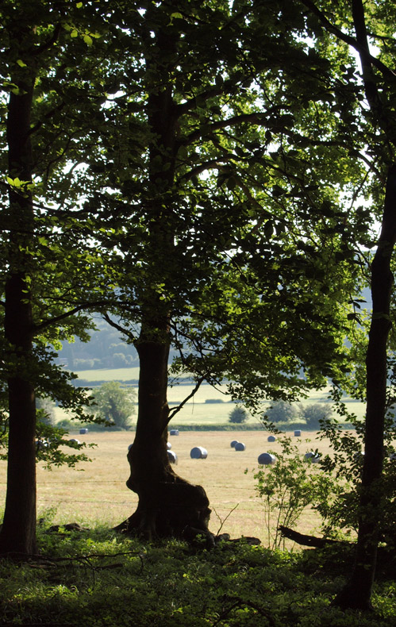
Jones’ Hill Wood
Construction will destroy 50% of the wood; Operation will destroy the tranquility of the remainder

Slide 13
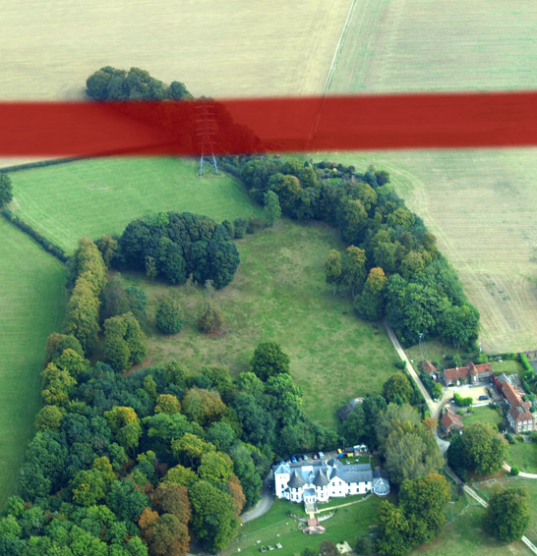
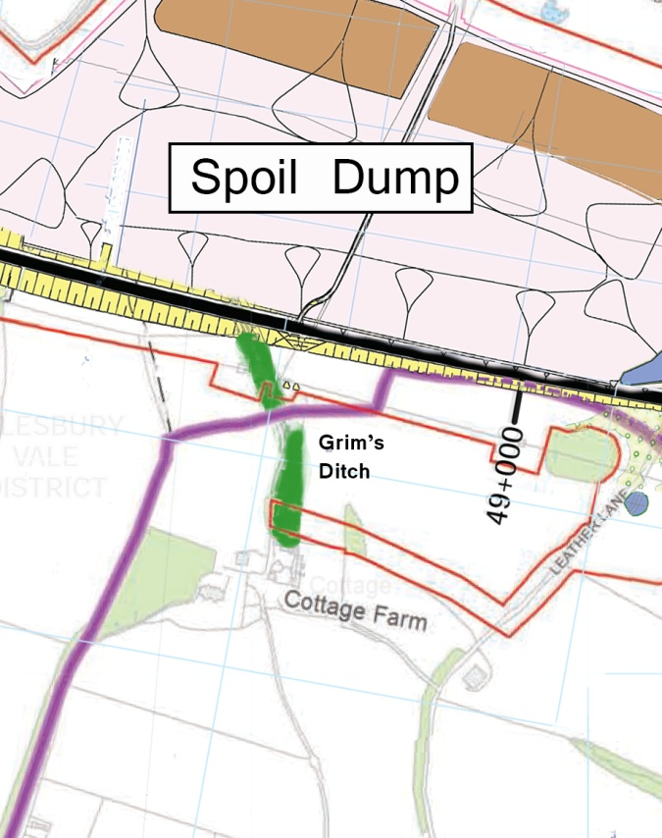
Grim’s Ditch
“a change such that the value of the
asset is totally altered and the setting comprehensively changed reducing the ability to understand and appreciate the resource in its historical context … “
… a high adverse impact and a major adverse effect.

Slide 14
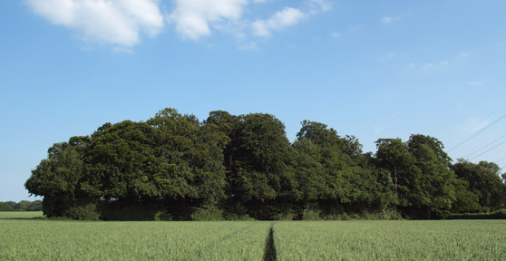
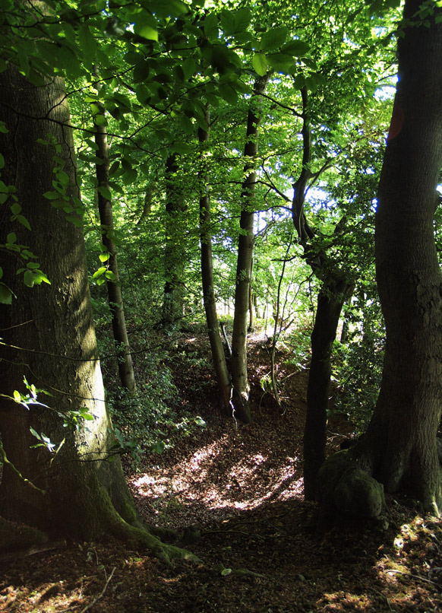
Grim’s Ditch
CFA10 6.4.18: Disturbance of known and potential archaeological remains of high value will occur at
Grim's Ditch scheduled monument …
Construction works for the cutting will require the
removal of an approximately 150m length of the
monument and the sustainable placement site at
the north-eastern end of the asset will also impinge on it.

